Slide 1

Behavior Management for Parents and Caregivers of Individuals with Intellectual or Developmental Disabilities
Jean B. Mankowski, PhD
September 11, 2019
Carolina Institute for Developmental Disabilities
UNC School of Medicine

Slide 2
What is Challenging Behavior
Defined differently by different people
For our purposes:
Challenging behavior is behavior that has an impact on one’s quality of life

Slide 3
Impact on the Individual / Self
Interferes with learning
Interferes with independence
Limits experiences (in the community, friendships, church)
Causes physical problems (self-injury, injury from aggression)
Reduces confidence / self-esteem
Causes isolation

Slide 4
Impact on Family
Increases stress
Can cause financial strain
Can increase anxiety/depression in parents or sibling
Fears of harm to self, sibling, staff
Parents have less time for other children, recreation, work
Behavior can be dangerous
Isolation from family or community supports
Overwhelming a family’s ability to cope

Slide 5
Challenges in MH/IDD
Psychiatric or mental health disorders are estimated as 2 - 4 times more likely in individuals with IDD
Determining an accurate psychiatric diagnosis is more difficult as the level of functioning or intellect declines.
Researchers have found as many as 1/3 of individuals with IDD have significant behavioral, mental, or personality disorders requiring MH services.

Slide 6
Why are individuals with IDD vulnerable to MH problems or challenging behavior?
language difficulties
limited coping or problem-solving skills
  (often associated with less language)
inadequate social supports
high rate of central nervous system impairment
social rejection/stigmatization
behavioral phenotypes associated with genetic conditions

Slide 7
Having both IDD and challenging behavior can have serious effects on the person’s daily functioning.
  Hinder educational progress
  Interfere or inhibit vocational activities
  Jeopardize residential placements
  Disrupt family and peer relationships
  Reduce quality of life
  Cause social rejection and stigmatization
  Increase risk of abuse/retaliation

Slide 8
Behavior Management for co-morbid MH/IDD
Individuals with MH/IDD have a high rate of behavioral challenges
Behavior plans are developed to respond to inappropriate behaviors and teach adaptive skills
Evidence-based treatment approaches have been empirically tested and proven effective
It is considered best practice to use evidence-based treatments developed for those with IDD to treat behavior disruptions, and teach appropriate behavior and independent skills

Slide 9
Evidence Based Treatments
Comprehensive Treatment Models (CTM)
(e.g., LEAP, Denver Model)
A set of practices used together to accomplish broad learning or developmental impact on the core deficits of ASD
have a theoretical framework
intense
occur across years
target multiple outcomes (social, communication)
Focused Intervention
(e.g., shaping, visual supports)
Individual interventions used to address a skill or behavior present in an individual with IDD or ASD
operationally defined, specific
shorter time course (weeks–months)
address specific outcomes
specific interventions are often components of CTMs
Interventions can be used together with other strategies and interventions to target different behaviors
Effective for broad range of ages, settings, behaviors
National Academy of Science Committee on Education for Children with Autism identified 10 CTMs in 2001.
Wong, Odom, Hume, et. al. (2014) Evidence-Based Practices for Children, Youth, and Young Adults with Autism Spectrum Disorder
Notes:
National Academy of Science Committee on Educational Interventions for Children with Autism (National Research Council, 2001) identified 10 CTMs.
Odom, Boyd, Hall, and Hume (2010) identified 30 CTM programs operating within the U.S.
***We are going to focus on the right side, the focused interventions in order to consider targeting specific behaviors or learning goals

Slide 10
Evidence-Based Practices Identified by the National Professional Development Center
Prompting
Reinforcement
Task Analysis and Chaining
Antecedent-based intervention
Extinction
Functional Communication Training
Functional Behavior Analysis
Response Interruption/Redirection
Differential Reinforcement
Visual Supports
Structured Work Systems
Parent Implemented Intervention
Social Narratives
Naturalistic Interventions
Peer Mediated Interventions
Pivotal Response Training
Social Skills Training Groups
Speech Generating Devices
Computer Aided Instruction
Picture Exchange Communication
Video Modeling
Discrete Trial Training
Time delay
Self-Management
Hume, K. A., & Odom, S. L. (2011). Best practices, policy, and future directions: Behavioral and psychosocial interventions. In D. Amaral, G. Dawson, & D. Geschwind (Eds.), Autism spectrum disorders (pp. 1295- 1308). New York, NY: Oxford University Press.

Slide 11
Individuals with IDD show increased risk for
behavior challenges
self-injury (head banging, skin picking)
repetitive behavior patterns
repetitive speech patterns
noncompliance
aggression
communication impairments
complex sensory needs
emotional dysregulation

Slide 12
Intervention is warranted when behaviors are
harmful to the self or others
unsafe or destructive
distressing to the individual/family
disruptive to learning
disruptive to social functioning
hindering participation in daily living or occupational activities

Slide 13
Evaluate Priorities
Set realistic goals
Start with small steps that can build on each other
First
  target behaviors that are dangerous
  target skills that would help to improve situations across several behavioral scenarios

Slide 14
Features of Effective Approaches
Clear—understood by all family/caregivers
Consistent—family/caregivers are on the same page with the interventions, expectations, and rewards
Feasible—strategies need to be practical and available across settings and team(s)
Steady—new strategies/interventions should continue for at least 3-4 weeks
Continuity—keep strategies in place even when the behavior improves
Remember Extinction Bursts Keep data if possible

Slide 15
Where to start?
Before intervention, figure out the motivation for the behavior:
All behavior occurs for a function or outcome!!
What purpose/function does the behavior serve?

Slide 16
~The Fancy Term~
Functional Behavior Analysis
Functional behavior analysis--a structured, systematic, and objective method for determining the communicative function underlying a maladaptive behavior for intervention planning purposes
Notes:
A functional analysis of behavior is completed to define the best approaches to use in a behavior plan/strategy. Systematic behavior programs can be implemented by family members, caregivers, or teachers in the person’s environment. Often the individual who is dually diagnosed may be able participate in the design of the behavioral program. When you have their ‘buy-in’ they might be more likely to participate and/or work toward improvement.

Slide 17
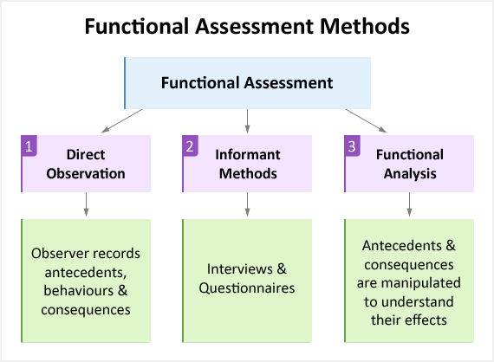

Slide 18
Components of an FBA
describe the interfering or problem behavior
identify antecedents and consequences
consider the function of the behavior
design intervention to replace behavior with a more adaptive behavior serving a similar function
Often most helpful with considering function of:
    self-injury elopement
    aggression towards others destructive behaviors
Data collection is an important part of the FBA
Notes:
Antecedent—an event or ‘trigger’ that happens before an behavior (e.g., loud noise)
Consequence –the result or effect of an event (e.g., running away)

Slide 19
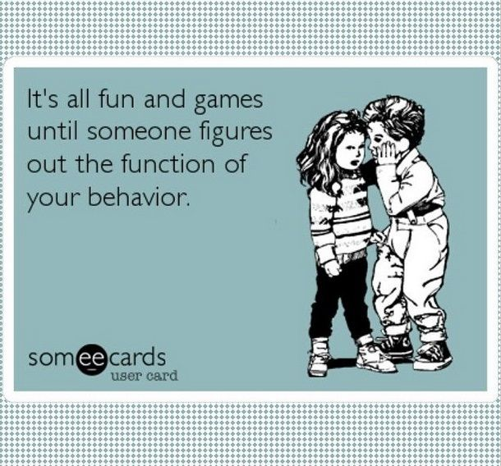

Slide 20
“FBAs” in the Home
Was this sudden? (consider illness, a change)
Rule out medical / physical problems
What are they trying to communicate?
Is this happening in certain places or at certain times?
What happened before and after the behavior?
What was my response? (attention, giving in)
What did they gain?

Slide 21
Most Common Behavioral Functions
Social attention
Desired object (tangible reinforcement)
Escape
Nonsocial reinforcement
Physical discomfort
Sensory avoidance
Sensory input

Slide 22
Challenging Behavior is a Form of Communication
Teach a more functional form of communication
Replace inappropriate behavior or subtle communicative acts with more appropriate and effective communicative behaviors
Communication Breakdown:
  teach a more appropriate communication skill
    e.g., pointing to or giving a cue card, vocalization, sign
  use differential reinforcement of taught behavior
  extinction
Notes:
Specifically with individuals with autism and/or limited language skills, giving them a visual way to communicate is often easy and quickly effective.
Re: Differential reinforcement. If one is using an inappropriate manner to communicate (i.e., screaming) the caregiver might ignore the inappropriate behavior. However, as soon as an appropriate overture is made, the caregiver should immediately engage, respond, and praise the communication/communication attempt.

Slide 23
**Positive Strategies for Supporting Behavior Improvement**
Embrace a mindset that is preventative rather than in response to behavior
Set expectations by saying what you want to see instead of what not to do
“Thank you for staying next to me when we go into this store” instead of “Don’t run away from me in the store”
Praise and encouragement should be frequent
Praise should be specific, not generic
“Great job putting away the dishes,”
instead of “Good job”

Slide 24
Positive Strategies (continued)
Validate emotions and/or give language to teach self expression
“I know you wanted to see the movie and now you are feeling angry that it is sold out.”
Ignore low level behaviors
  whining, fidgeting, noises, repetitive behaviors
Differentiate attention toward positive or prosocial behaviors

Slide 25
Positive Strategies (continued)
Use positive language
Avoid Saying No, Don’t, and Stop
  “I like how you said excuse me,” or “Thank you for covering your mouth,” instead of, “No burping!”
  “Joe, it is time to load the dishwasher,” instead of “No yelling”

Slide 26
Response Interruption/Redirection
Use of a prompt, comment, or distractors when an unwanted behavior is occurring to divert attention away from the behavior
Most often used to address behaviors that are repetitive, stereotypical, and/or self-injurious and/or thoughts that are perseverative
Interrupt behavior and direct to more appropriate, alternative behavior
  typically used for behaviors that are not maintained by attention or escape
  such behaviors are often maintained by sensory reinforcement

Slide 27
Positive De-escalation
When behavior is escalating:
  be aware of warning signs / triggers
  reduce stressors in environment, if possible
  reduce language (use simple, clear, concrete language)
  pair words with visual support if possible
  keep voice neutral
  keep facial expression neutral
  give space
  give calming object
  praise attempts to self-regulate or use strategies

Slide 28
What NOT to do when
Trying to De-escalate
Give into what they want
Show anger
Raise voice
Threaten or lecture
Physically intervene unless necessary for safety

Slide 29
Positive Strategies (continued)
Visual aids, photographs or video models are great ways to teach/show expected behavior
Provide opportunities for success
Schedule breaks throughout the day for preferred activities
Allow individual to request a break when needed
  for less-verbal individuals make a visual break card available

Slide 30
Positive Strategies (continued)
Provide opportunities for choice making (available choices can be controlled)
Establish a reward system consistent with the individual’s level of understanding
Allow time to do their preference
  repetitive behavior, discussion of restricted interest, playing/looking at restricted interests
    -Does this need to be scheduled?

Slide 31
Intervention Strategies
Often Taught

Slide 32
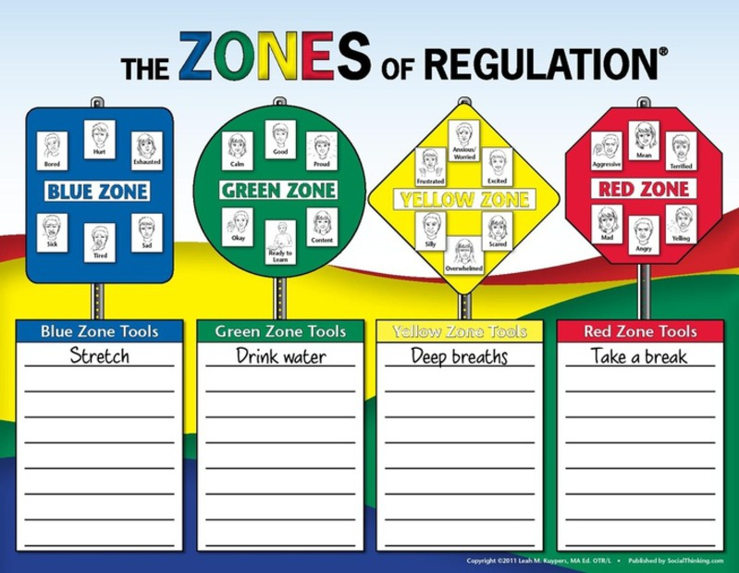
Notes:
The Zones of Regulation: A Curriculum Designed to Foster Self-Regulation and Emotional Control (2011, Social Thinking Publishing) is a curriculum developed by Leah Kuypers, M.A. Ed., OTR/L to help individuals acquire self-regulation skills. Lessons and activities assist individuals to recognize when they are in the different moods/feelings (i.e. zones) and learn the tools (e.g., sensory supports, calming techniques, strategies) to regulate toward the green zone.

Slide 33
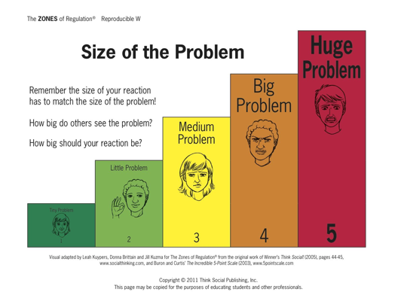

Slide 34
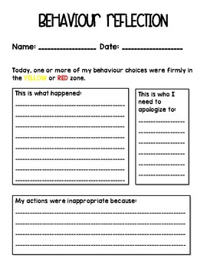

Slide 35
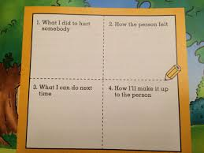
Four Square Apology

Slide 36
Social Narratives/Social Stories
Scripts used to explain the “rules” of social situations by highlighting relevant cues and defining appropriate responses
Can be individualized
Usually written in 1st person
Can include visual aids
Use of these stories also helps consider various social situations with peers/co-workers/strangers
Can be created to relate to a variety of social situations and contexts, such as making introductions, getting and giving directions, or asking for help
www.thegraycenter.org/socialstories.cfm
www.rsaffran.tripod.com/social.html
www.socialstories.com/
www.autismspeaks.org/family-services/personalized-stories
Notes:
While these are most often thought of as useful for individuals with autism spectrum disorders, they can be quite effective for individuals who have less understanding of social nuances, difficulties attending to the environment around them, unease entering new/novel situations, as well as individuals prone to withdrawal and social anxiety

Slide 37
Visual Supports
Visual cues about one’s activity, routine, or expectation
Can be quite varied in form and function
Used to
  organize the environment
  establish expectations around activities
    schedules instructions
    work systems video modeling
  provide reminders
    timers (countdowns) activities to chose from
    appropriate behavior when something is complete
Notes:
Visual supports can be simple reminders or act to organize and structure the environment. They can be helpful for individuals who may be disorganized, confused, have attention difficulties, doing something for the first time, or having a difficult time understanding a task/environment.

Slide 38
Types of visual structure
Photographs
Drawings
Words
Objects
Physical structure
Work Systems
Visual Timers
Checklists
Learning Strips
Schedules
Graphic organizers
Organizational systems
Scripts
Partitions or tape

Slide 39
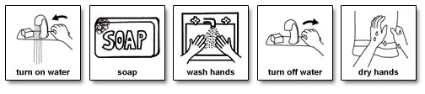
Learning Scripts
Detailed script for washing hands
www.do2learn.com

Slide 40
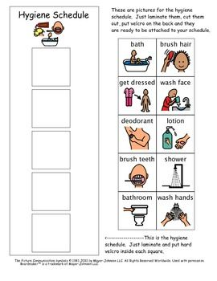

Slide 41

Introducing flexibility or more of something
Example (more time in the community)
  Go Slow
  Consider preferred activities before and after
  Use options of high interest (restaurant, swimming)
  Present options (use pictures)
  Give advance warning of when the outing will take place.
    On schedule/calendar
    Clearly show what might not happen
    Consider a picture book to describe outing
  Start with one new outing a week
  Once comfortable with this outing, begin introducing another new outing
  Use verbal and visual cues to ensure they know (home) is directly afterward

Slide 42
Cognitive Coping Skills
Teach coping skills when individual is calm in and a good space
Use visuals to teach skills
  Visuals can serve as reminders later
Practice often
Reward practice and use!

Slide 43

Visual Scripts for Teaching Skills
Take Deep Breaths
Smell the flower
Blow out the candle
Smell the flower
Blow out the candle
Smell the flower
Blow out the candle

Slide 44
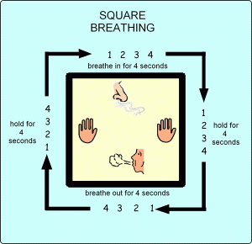

Slide 45
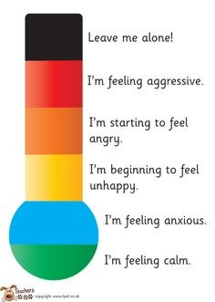
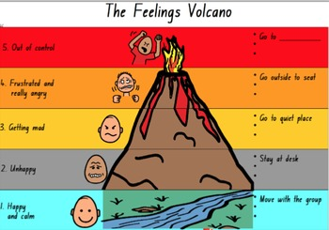

Slide 46
HOW BIG IS MY FEAR?
Notes:
From Morgan

Slide 47
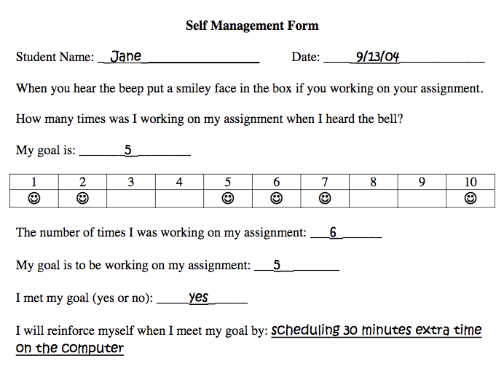
Self Management Techniques

Slide 48
Keep Others Informed
(staff, volunteers, instructors)
A Dictionary of All Things Joe:
List:
  words or approximations & what they mean
  nonverbal cues that Joe is becoming upset
  ‘hot topics’ to be avoided if Joe brings them up
  verbal cues that Joe is getting agitated
  distractors and redirections for Joe
  calming strategies Joe knows
This list will need to be updated frequently.

Slide 49
Consider Structuring the Environment
Visuals
  Schedules (use pictures if needed)
  calendars
  checklists
  consistent routines
  visual timers
  Add a calm down space
  consider troublesome distractions or triggers in the environment (alarms, outside noise, flickering lights)

Slide 50
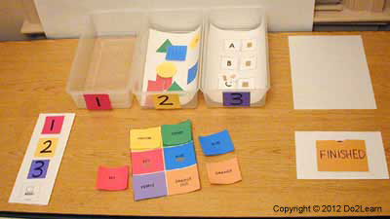
Workstation

Slide 51
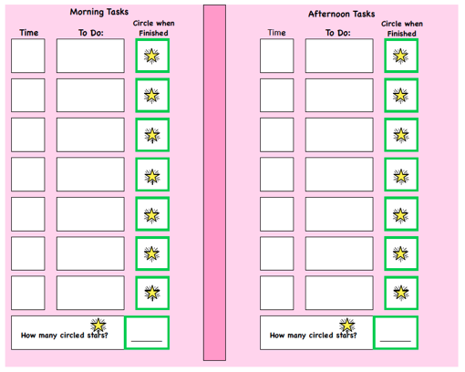

Slide 52
Safe Space
Designated Space
  corner of room
  large closet
Contents and Soothing Activities
  visual calming strip
  bean bag
  weighted blanket
  fidgets
  soothing music
  coloring/drawing supplies

Slide 53
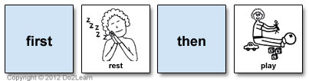
Use First Then

Slide 54
Taking a Break (or Time Out) for major infractions like aggression
Losing access to preferable things/attention by removing the individual from the rewarding setting/activity
Remove Joe from video (to other room if possible)
Use concise wording “you need a break in your room”
Do not talk to him (or provide positive or negative attention)
Keep eyes on if necessary (turn body, use gym mat)
Consider using a timer (depending on cognitive level)
Once calm/time is up, give praise of calming self down, he can to return to what he was doing
No need to rehash infraction
Example: Joe is watching a high interest video and his housemate walks by and he reaches out and hits her

Slide 55
Other less studied strategies:
Cognitive Techniques
Mindfulness
Progressive Muscle Relaxation

Slide 56
Mindfulness
More appropriate and effective for adolescents with mild to moderate ID or ASD than for those with lower cognitive ability

Slide 57
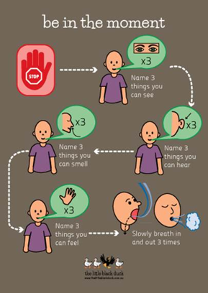

Slide 58
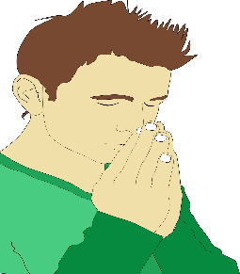


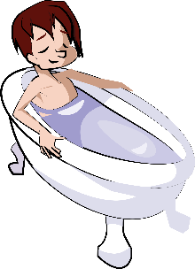


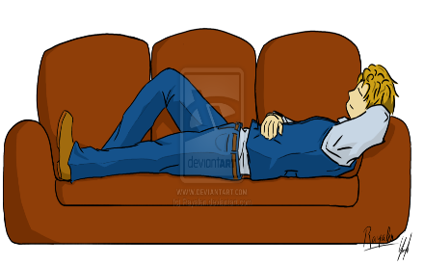
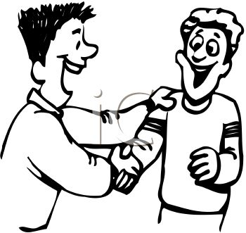
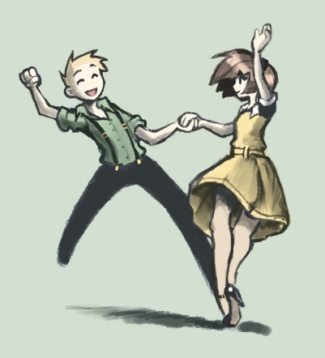


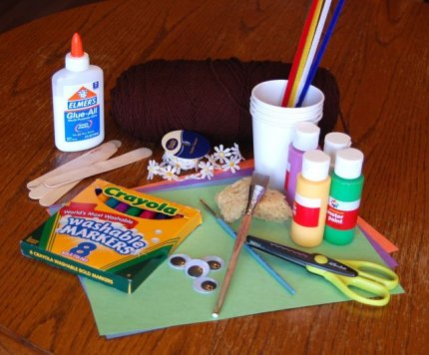
Circle a Pleasant Event

Slide 59
Progressive Muscle Relaxation

Slide 60
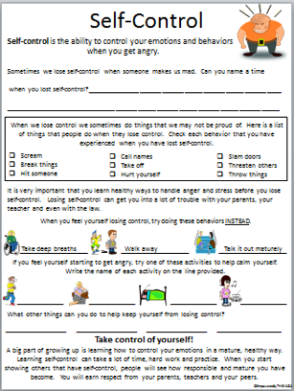

Slide 61
Questions???

